Slide 1

Sub Header
Data Analytics with Python
Brandon Steed
Data Analyst II
Notes:
So I’m pretty proud of the graphic I made here. My wife saw me working on it and asked where I got the photo of the snake. We have chickens and ducks, and I am always getting snakes out of the coop- usually rat snakes, and occasionally there will be a king snakes in there. She knew it wasn’t a native snake, but I guess she was worried that we had a big, scary, exotic snake terrorizing our ducks and chickens.

Slide 2

Intro
Intro
I am a part of the Data Analytics and Process Automation team at the Georgia Department of Audits and Accounts. A former educator with a master’s degree in Mathematics Education and a large amount of knowledge of statistics, I completed a data science program and learned Python. I have used these skills to assist with various engagements across business units.
Notes:
First I’m going to tell you a little about our approach to data analytics here in Georgia- we have hybrid data analytics model.
Some our analytics are done in DAPA (Data Analytics and Process Automation team), and some is done throughout our other business units.
We assist other divisions (which is often audit teams) with their data analysis needs.
We generally handle work with large datasets or more complicated tasks. And we handle confidential and sensitive data.
Some work might begin with us and then get handed off to other units for future years.
We research tools, techniques, and storage practices. And we look to see what other places are accomplishing with data.
Another goal we have is to advance data strategy throughout the department.

Slide 3

Why Python?
“Python is the second best language for everything.” - unknown
Notes:
Poll- how many people have used Python? R?
Read quote
I don’t totally agree with the quote, but I understand why I’ve heard and seen this so many times. Python can be used for so many things, but it’s not always the best choice. In my opinion Python is the best programming language for many tasks, and there are other things where Python is not a very good choice at all. The point is that Python is a very versatile language.

Slide 4
Why Python?
Open source
Very readable
Versatile
Provides a greater amount of control
Time savings
Python integration available in many applications
Notes:
Easier to learn than other programming languages
Syntax is more similar to written language
So many uses
More control than most software with a GUI
Scripting allows processes to be automated or code can be saved from year to year- provides significant time savings in future years
Integration- PowerBI, Tableau, IDEA, Arbutus, ArcGIS, cloud services

Slide 5
What can Python be used for?
Web development (back end)
Desktop applications
DevOps
Software testing
Web scraping
Automation
Image and video processing
Data analysis and visualization
Machine learning
Notes:
Batch image processing
Video processing-Star Wars

Slide 6
What is Python not good for?
Developing mobile apps
Game development
Low level applications
Memory intensive tasks
Anything where speed is the top priority
Notes:
Mobile apps can be developed in Python, but its not that common
Same with game development- simple games are fine
Low level applications require a language closer to hardware
Python tends to use a lot of RAM
I have 32 gb of RAM, but sometimes I run out of memory when running my Python scripts and I have to use the VM they set up for me.
Sometimes I specify to delete objects
C is much faster
Cython

Slide 7

Anaconda
Comes preloaded with numerous libraries helpful for working with data
Conda is Anaconda’s package and environment manager
Simple to set up
Generally does not require administrator privileges.
Python, R, C++, Java, Rust
The World’s Most Popular Data Science Platform
Notes:
Anaconda is a great choice for getting started with Python if you are using Python primarily for data analysis.
Out of the box solution- 1st bp
Comes with conda to manage the Python environment
I’ve installed Anaconda and I’ve set up Python environments manually- Anaconda is much easier, but it’s not always best depending on what you are using it for.
4 bp- Anaconda install helps you avoid issues with path
On my previous laptop I had Anaconda installed along with another instance of Python, but that was difficult to manage- path issues, conflicts, had to make sure you were pointed to the correct instance
Python and R are most commonly used within Anaconda, but other languages can be used as well-C++, Java Rust

Slide 8
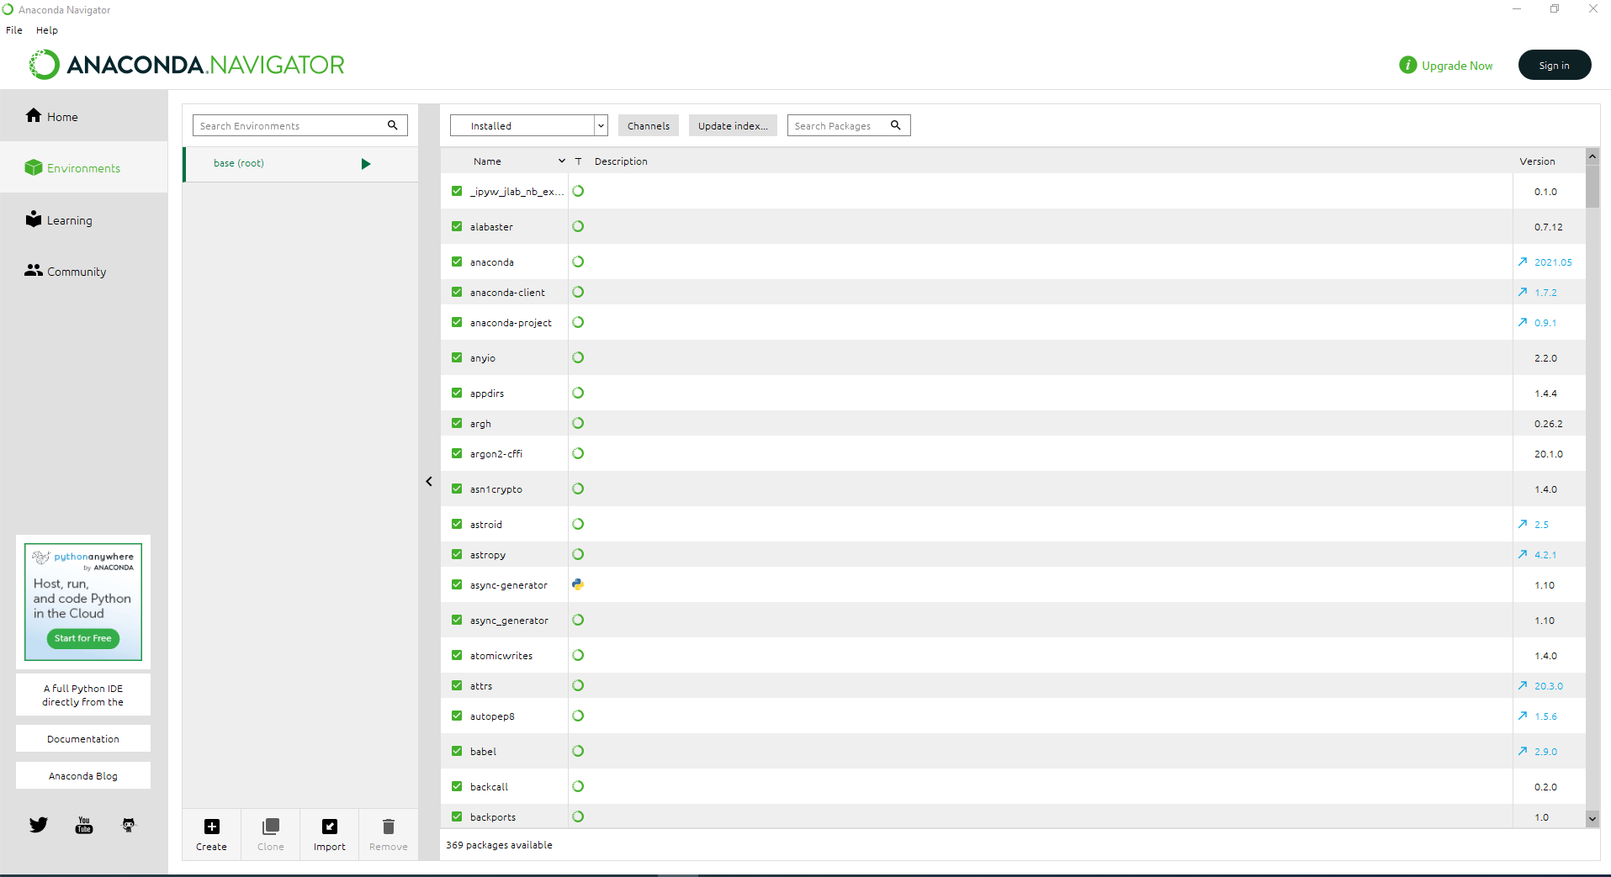
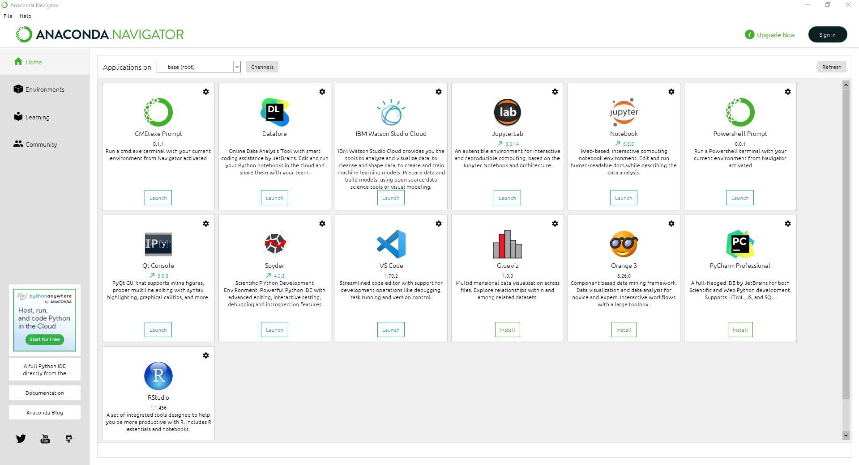
Anaconda Navigator
Notes:
GUI
Environment manager- set up different environments with different version of Python or Python libraries
Application panel- Jupyter notebook, JupyterLab, R, Spyder

Slide 9
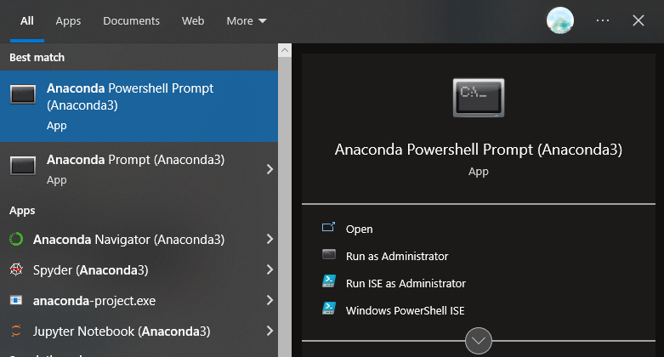
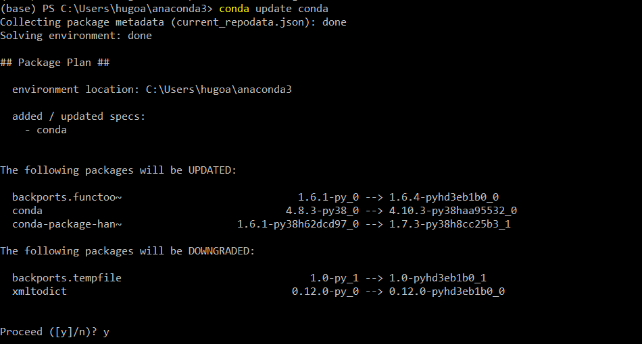
Anaconda Prompt
Notes:
I usually don’t use the graphical interface
Anaconda Powershell Prompt- type commands to open what I need there, manage environment, update and install new packages

Slide 10



IDE’s
An IDE (Integrated Development Environment) is a software application that provides an interface for code development, testing, and debugging.
PyCharm, Sublime, Spyder, Microsoft Visual Studio
Contain many useful features such as color-coding for syntax, navigation tools, and debugging tools

Slide 11
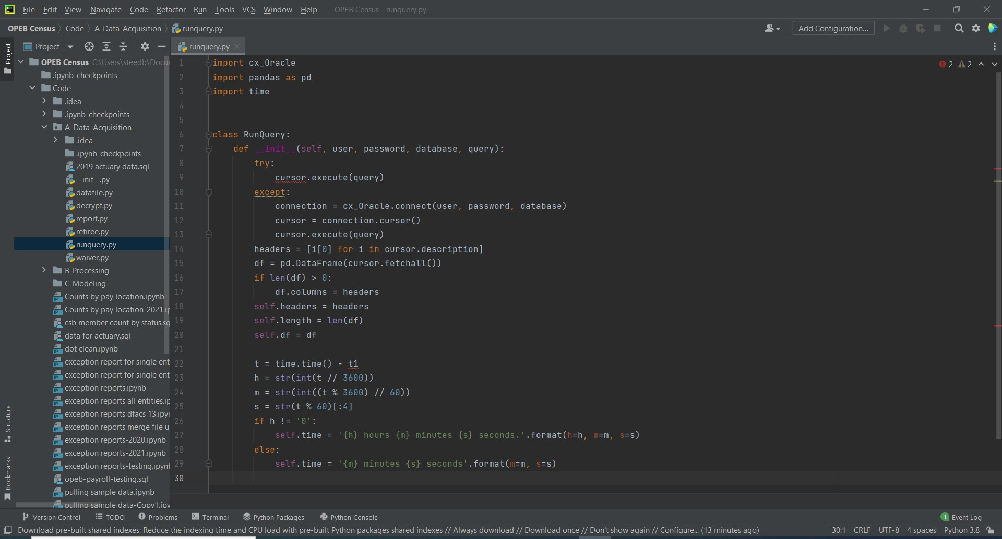

Slide 12







Python Libraries
Notes:
This is where versatility comes in.
Over 300k libraries available in Pypi (official software repository)
Fewer available in Conda repository

Slide 13
Python Libraries
Libraries are modules of code that perform certain operations. They allow us to use code that has already been written.
pip – package installer for Python
conda – Anaconda’s package manager
Notes:
Example- I have a list of numerical values
I need to find the mean, median, and standard deviation
I could write out code to do each step needed to find these, but I don’t need to
Python had a library called NumPy that has the code written already to find mean, median, and SD
All I need to do is import the NumPy library and run three very simple functions- numpy.mean(), numpy.median(), numpy.sd()
You can also create your own libraries

Slide 14

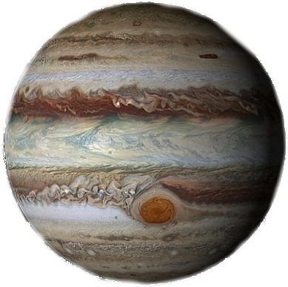
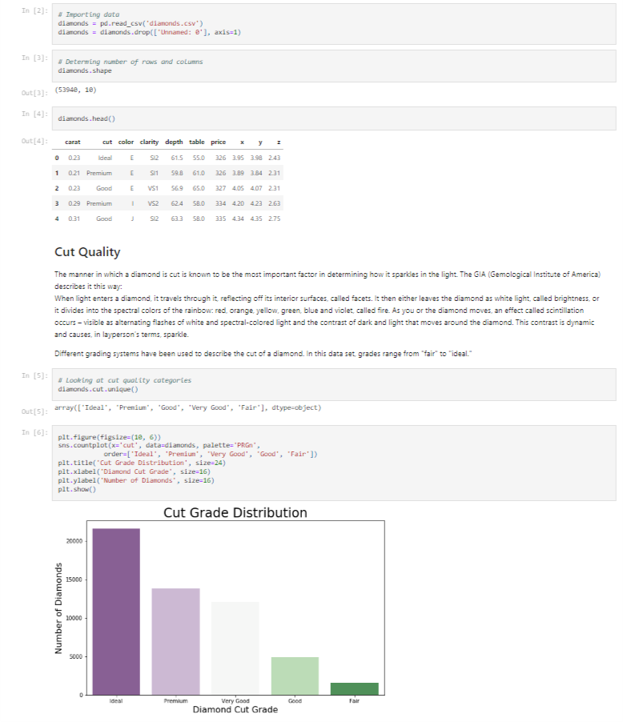
Jupyter Notebook
“The Jupyter Notebook is the original web application for creating and sharing computational documents. It offers a simple, streamlined, document-centric experience.”
Notes:
Provide to audit teams
Good for documentation
Pull up jupyter notebook and run

Slide 15
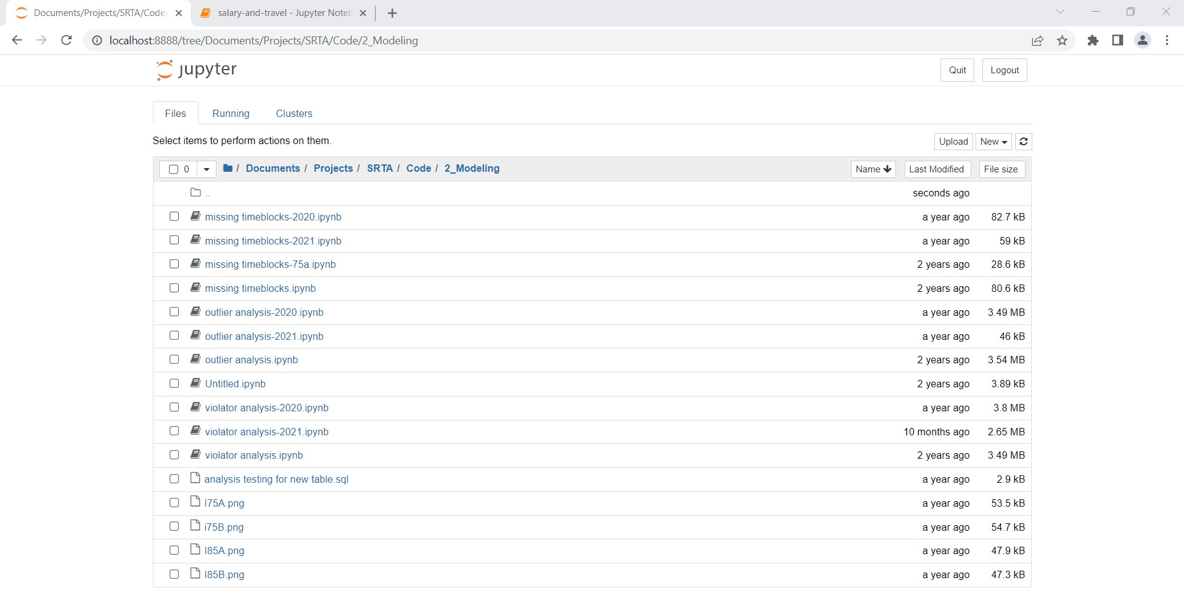

Slide 16
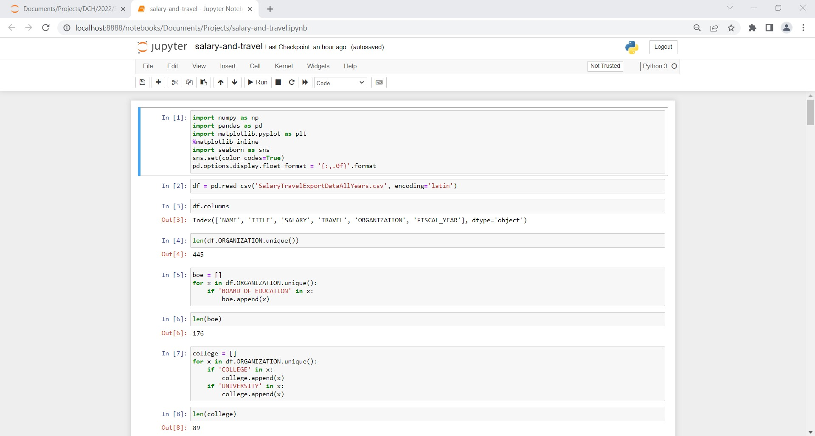

Slide 17

Jupyter Notebook
Runs in browser
Code is kept all in one document.
Broken into cells to make it easier to read
Can include charts, diagrams, and other visualizations
Data can be displayed within
Test results can be included
Notes:
Go down list

Slide 18

Pandas
The stated goal is to become “the most powerful and flexible open source data analysis/manipulation tool available in any language.”
Notes:
Python data analysis library
Python library for dealing with data tables

Slide 19

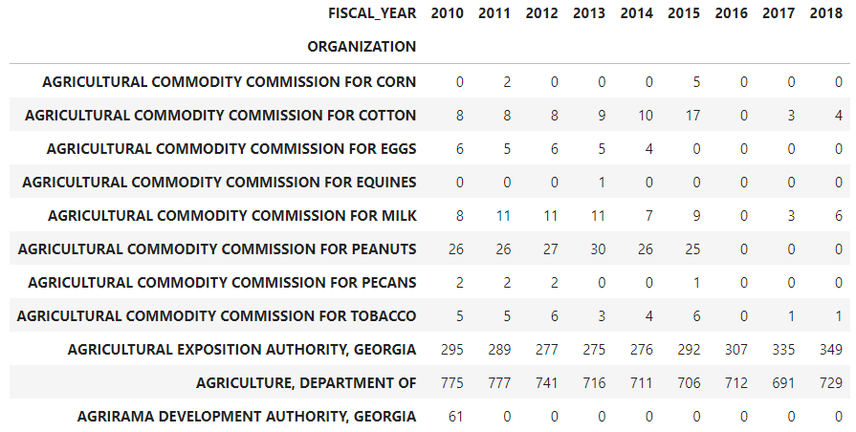
Pandas
Data tables are referred to as DataFrames.
Fast
Offers lots of control
Read data, write data, select subsets, create new columns, reshape, combine data, manipulate values, calculate summary statistics
Notes:
Used to clean data countless times
SRTA Tolling data – joined thousands of excel sheets
Auditors were trying to do this manually
Used coded logic to filter out sheets that were not needed.
Fix column issues
Standardized values from different sheets
Added needed info (toll facility)

Slide 20
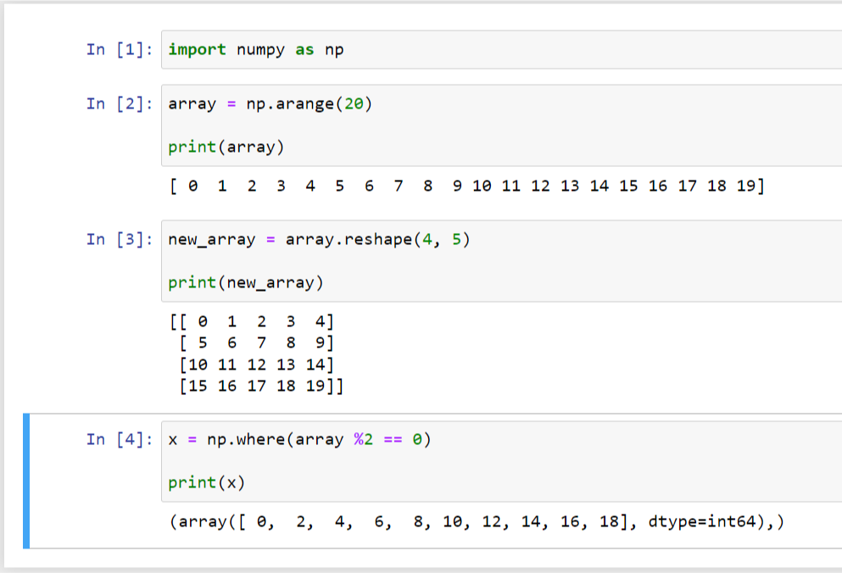
NumPy
Pandas is built on top of NumPy
Useful in manipulating data
NumPy functions can efficiently perform numerical operations on large sets of data
Notes:
SRTA- used numpy functions to find outliers in revenue and violations
Arrays- matrix
Useful for shaping flat data and loading into pandas df

Slide 21
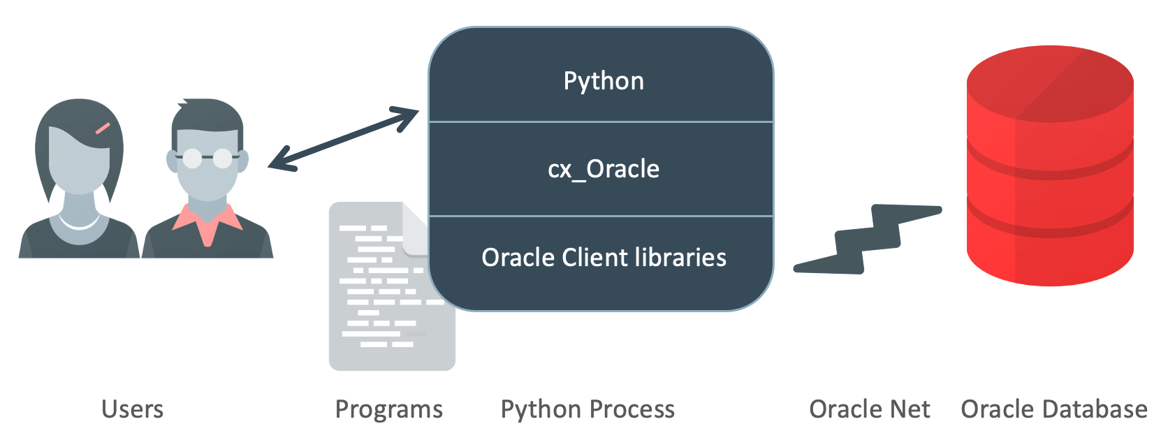
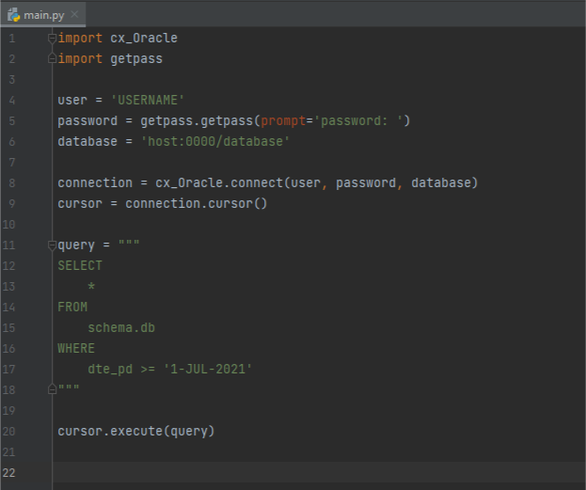
cx_Oracle
Cx_Oracle allows access to Oracle Database. For other databases, other options exist. One popular library is SQLAlchemy.
Notes:
When I first started at the dept., I had to run queries in SQLdeveloper, save data to CSV, and then import the files into Pandas.
Especially annoying when you are pulling many sets of data.
Worked with DBA to connect directly to DB from Python

Slide 22

Cx_Oracle
Data can be pulled directly into Python
Great for automating queries to the database
Python string formatting method makes it easy to run several similar queries
Notes:
SRTA only used 3 queries and used pandas to break it down
Employee census data over 100 queries
Written as a few queries with placeholder and filled with entity name
Similar to bind variable in oracle/SQL

Slide 23
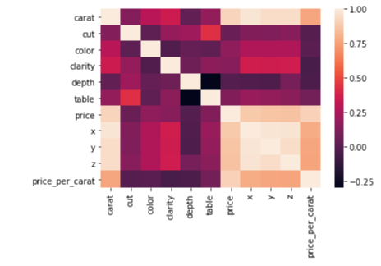
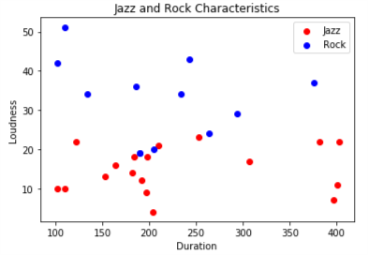
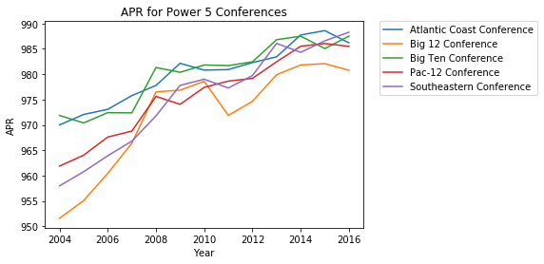
Matplotlib
“Matplotlib is a comprehensive library for creating static, animated, and interactive visualizations in Python.”

Slide 24
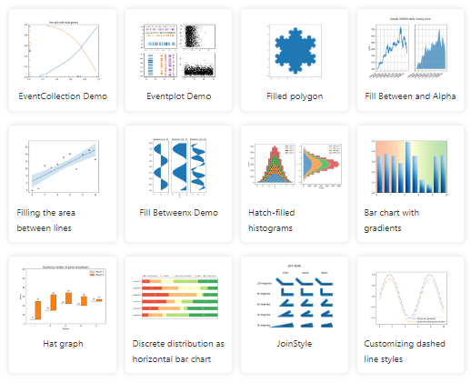
Matplotlib
Good for creating basic graphs.
Visualizations can be highly customized.
Useful to visualize data very quickly
Notes:
SRTA – created many reports (excel) for each toll facility
violations, revenue, time gaps
Broken down 2 different ways- by month, day of week
Created various visuals w/ matplotlib
Saved as PNG
Embedded visuals into excel files- used PyXL

Slide 25
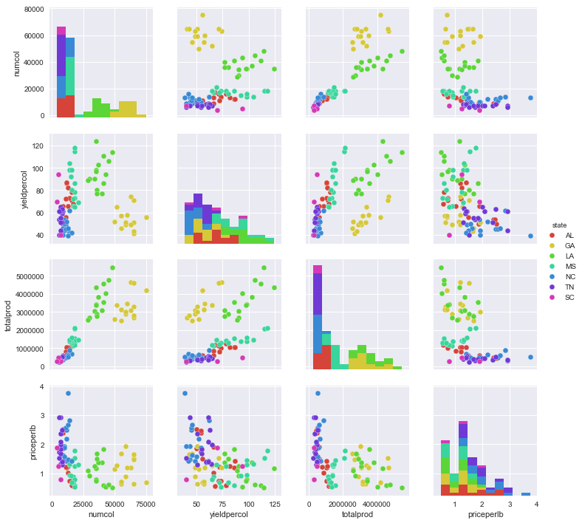
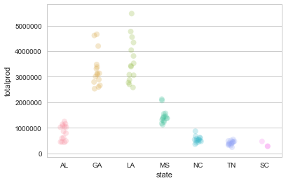
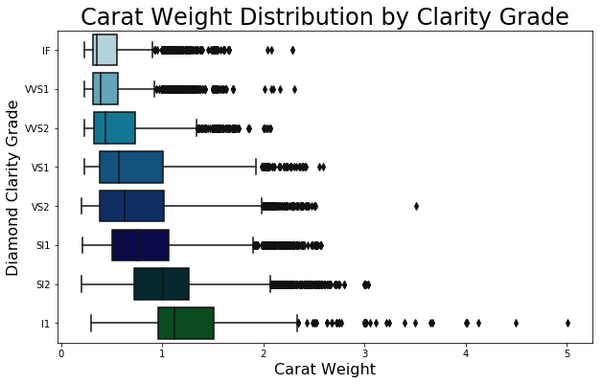
Seaborn

Slide 26
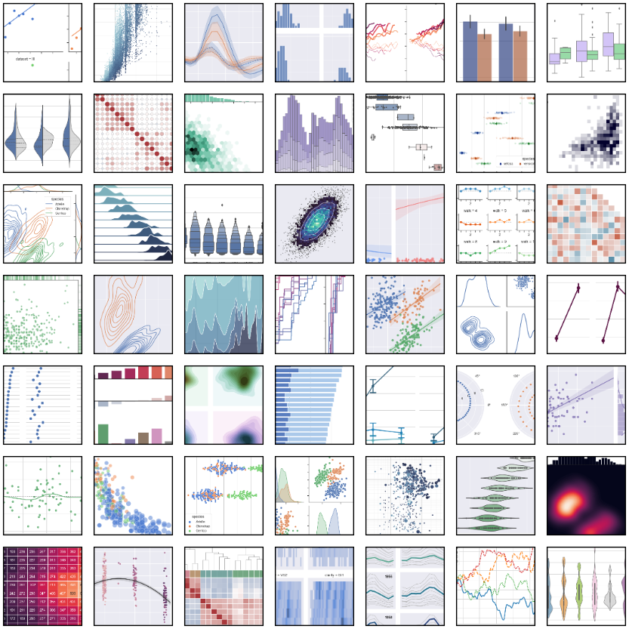
Seaborn
Built on top of matplotlib.
Visualizations can be highly customized.
Visualizations look very nice

Slide 27
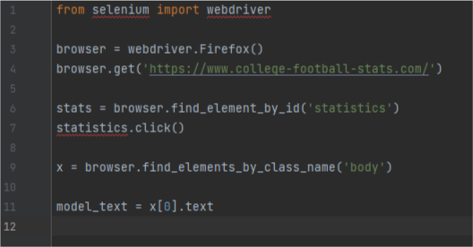
Selenium
“Selenium automates browsers. That's it!
What you do with that power is entirely up to you.”

Slide 28
Selenium
Used for automated testing
Can automate web-based administration tasks
Useful for scraping data from the web
Notes:
Most common use I know of for Selenium is automated web testing- make sure things work correctly in different browsers
Not what I use it for
My favorite uses are automating web-based tasks and scraping data
Budget
Scrape statistics for use in fantasy sports models
Our dept. uses BluePrism for these types of tasks, but I prefer Selenium

Slide 29

Pytesseract
Python-tesseract is an optical character recognition (OCR) tool for Python. It uses Google’s Tesseract-OCR Engine to “read” text.
Notes:
Works fairly well

Slide 30
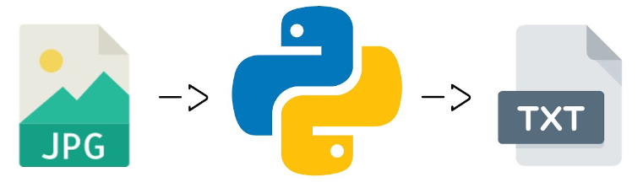
Pytesseract
Documents must be in image format
Settings can be configured, but works well with default settings for many documents.
Notes:
Use with PIL
Not great with handwritten documents.
Pandas df with position values
If you have in-line text, not a lot of problems
Trying to find better solution with turning PDF’s into tabular data

Slide 31

Scikit-learn
“Scikit-learn is an open source machine learning library that supports supervised and unsupervised learning. It also provides various tools for model fitting, data preprocessing, model selection, model evaluation, and many other utilities.”
Notes:
Most popular library for machine learning algorithms

Slide 32
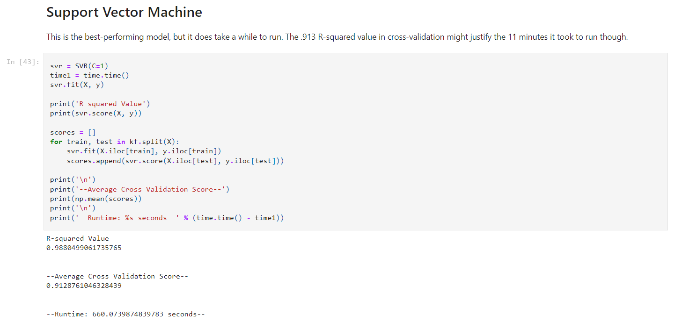
Scikit-learn
Includes numerous machine learning algorithms
Only well established, widely used, and useful algorithms are included.
Supervised learning- trained on labeled datasets
Unsupervised learning- patterns identified from unlabeled data
Notes:
SKL included most of the ML algorithms you would use with structured data.
Included ML algorithms are well tested; all have white papers published
Classification- from linear regression to random forests
Regression
Clustering – divide data into groups or outlier detection

Slide 33


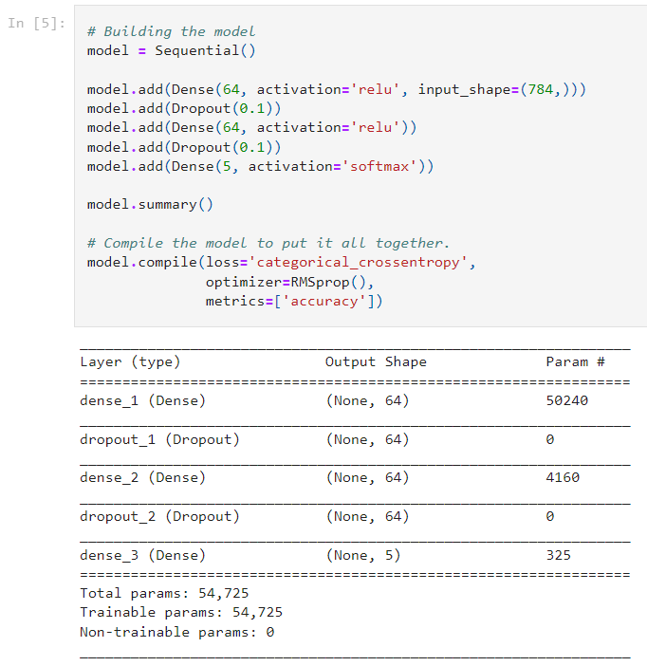

Deep Learning Libraries

Slide 34

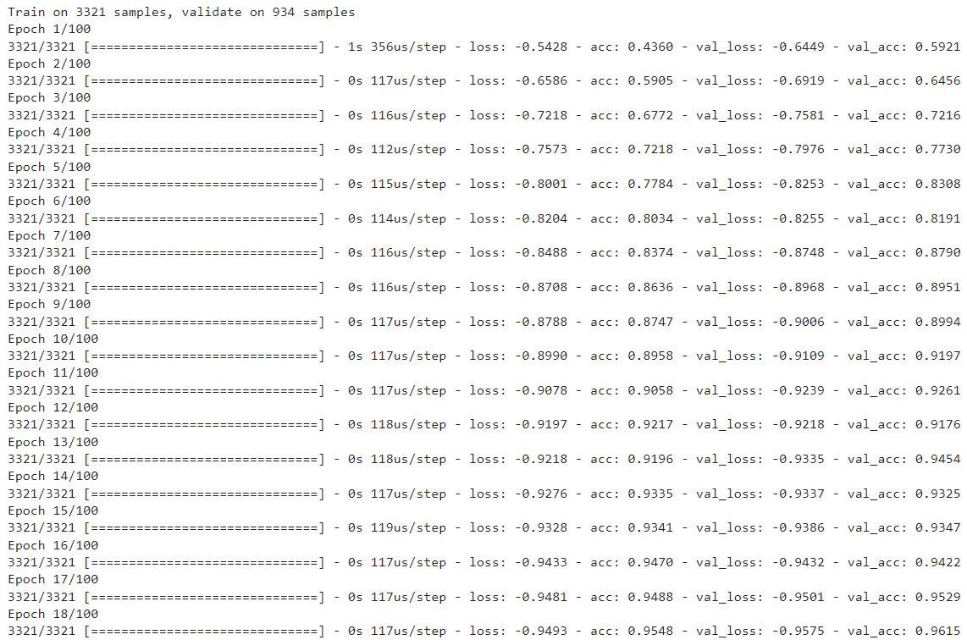
Deep Learning Libraries
Use artificial neural networks
Overkill for many applications
Slow and not necessarily best performing on tabular data
Notes:
I created an application using TF and Keras to identify hardware- various screws, specialty nuts and bolts, etc.
Training models was very slow.
DL doesn’t necessarily perform better with tabular data. In some cases you might get a slightly better result, but takes much more time to train.

Slide 35

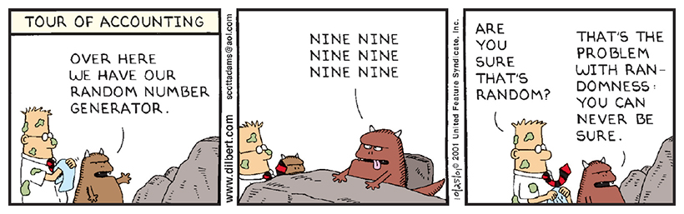
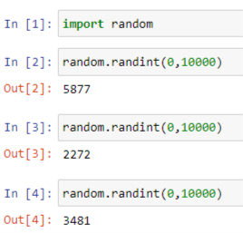
Random
Random
Random is a built in library.
Pseudo-random number generator
Offers a variety of distributions and functions
Useful in sampling
Notes:
Used to sample Medicaid eligibility
More consistent at providing a good sample
-especially when union across table
Easier to stratify

Slide 36
Learning Resources
W3schools – many good Python tutorials
codewars –Python challenges from novice to expert
Python
Anaconda
Jupyter
Pandas
NumPy
Matplotlib
Seaborn
Scikit-learn
Selenium
Pytesseract
Notes:
Used to sample Medicaid eligibility
More consistent at providing a good sample
-especially when union across table
Easier to stratify

Slide 37

Contact
Contact Info
Brandon Steed
steedb@audits.ga.gov
Notes:
Used to sample Medicaid eligibility
More consistent at providing a good sample
-especially when union across table
Easier to stratify

